Slide 1
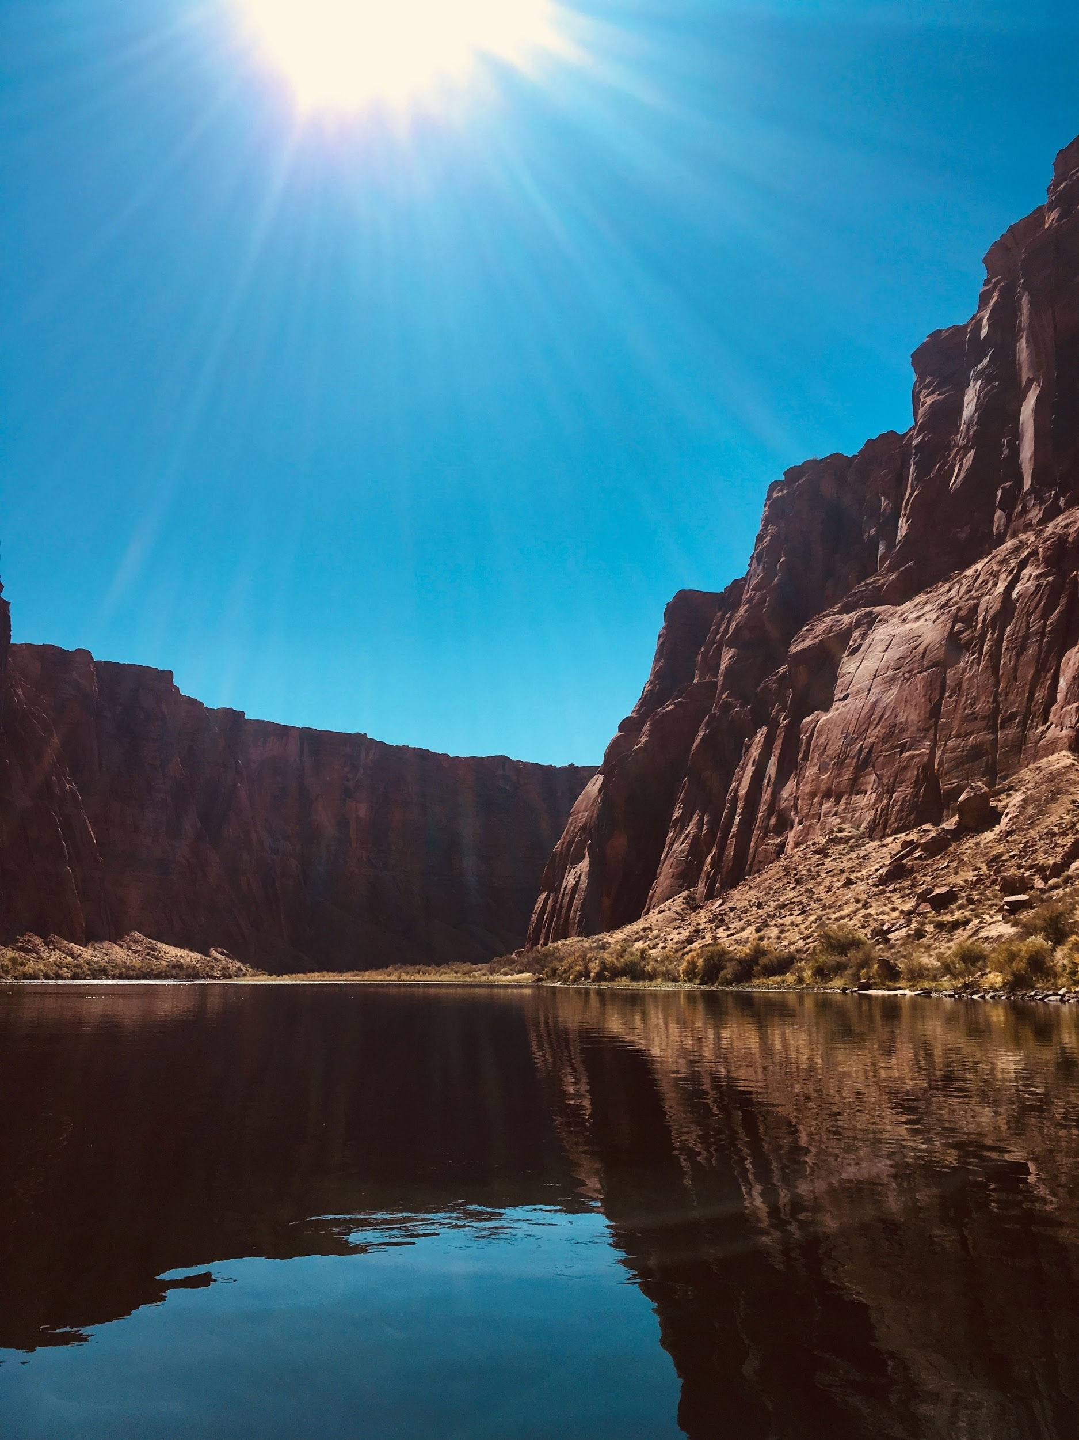

Three Canyons Trip
California Crosspoint Academy
2019 Oct
Name:_____________
Notes:
TO do list
Geology page
Get a clear essential question (geology question)
Provide some information about this spot
Interactive

Slide 3
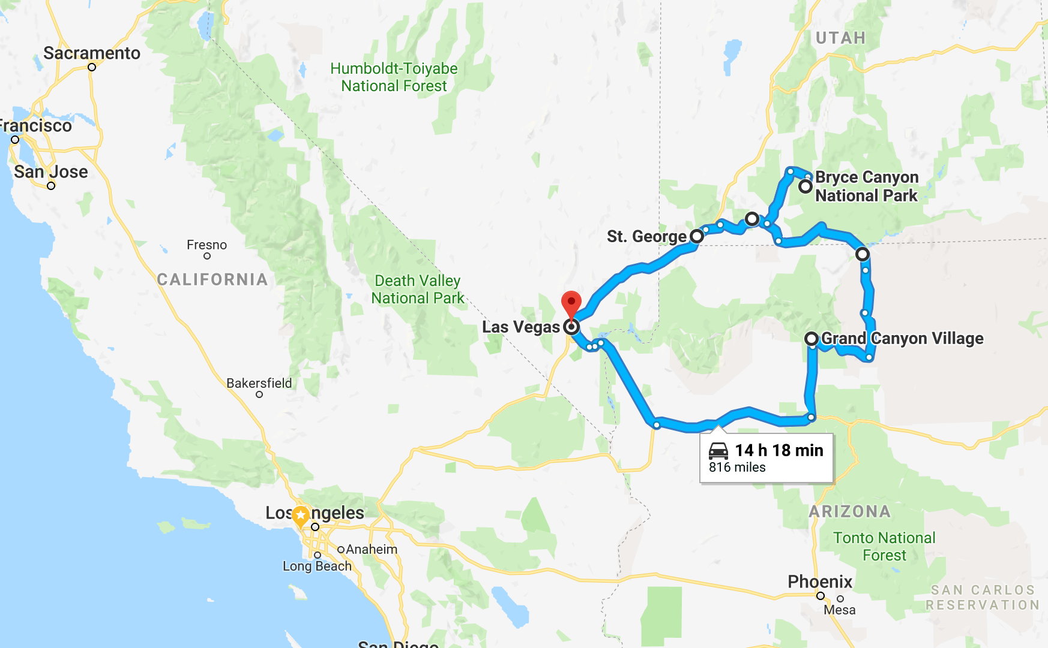
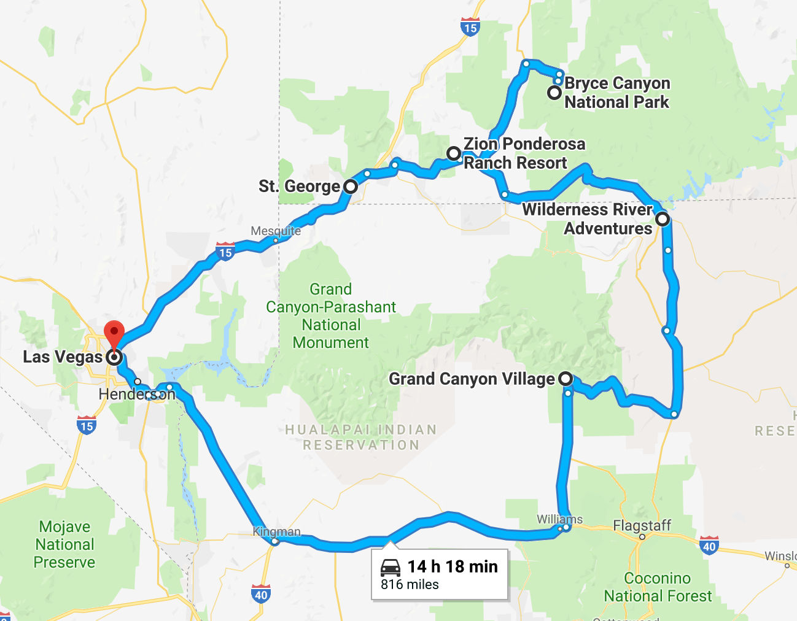
Three Canyons Route

Slide 4
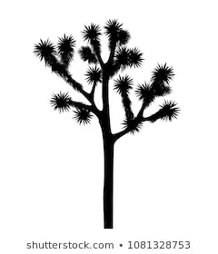
Points of Interest
Hoover Dam
Constructed between 1931-1936 during the Great Depression, Hoover Dam is considered one of the seven engineering wonders of the world.
San Francisco Volcanic Field
The vast San Francisco Volcanic Field in northern Arizona has more than 550 vents. Many of the volcano cinder cone shapes. A cinder cone or scoria cone is a steep conical hill of loose pyroclastic fragments, such as either volcanic clinkers, cinders, volcanic ash, or scoria that has been built around a volcanic vent.
Joshua Tree
The name Joshua tree was given by a group of Mormon settlers crossing the Mojave Desert in the mid-19th century. The tree's unique shape reminded them of a Biblical story in which Joshua reaches his hands up to the sky in prayer.
Painted Desert
Art comes to life in the Painted Desert. The beauty of the desert is the result of volcanic eruptions, earthquakes, floods and sunlight. Located in a region which has been home to the Navajo and Hopi people for hundreds of year, this desert stretches from the Grand Canyon National Park to the Petrified Forest National Park. As you travel to the Grand Canyon keep your eyes open for the display of lavender, grey, red and orange hues in the clay and sandstone deposits.
Red Rock Canyon:
Located where the southernmost tip of the Sierra Nevada converge with the El Paso Range, Red Rock Canyon State Park features scenic desert cliffs, buttes and spectacular rock formations.Historically, the area was once home to the Kawaiisu Indians, who left petroglyphs in the El Paso mountains and other evidence of their inhabitation. Hidden behind the scenes in the layers of rock is what amounts to paleontologists as a treasure trove. For almost a century, paleontologists have been combing through these layers and making important discoveries about the history of mammalian life in these parts. California State Parks, State of California. “Red Rock Canyon SP.” CA State Parks, www.parks.ca.gov/?page_id=631.
Balancing Rocks
As we exit Lee’s Ferry at the end our Colorado River float trip, look for the huge balancing boulders on the right…..or the left….but probably on the right. How do you think these balancing boulders came to be?

Slide 5
Table of Contents
Day 1: The Grand Canyon
Geology: How are the relative ages of rock measured? ---pg. 5
History: 100 years of Grand Canyon ---pg. 6
Activity: Video Clip of Grand Canyon ---pg. 7
Devotion: Psalm 121 ---pg. 8
Day 2: Glen Canyon Dam and the Colorado River
Geology: Weathering and Glen Canyon Dam ---pg. 10
Petroglyphs ---pg. 11
Grand Canyon Crossword ---pg. 12
Devotion: Psalm 125 ---pg. 13
Day 3: Bryce Canyon
Geology: Bryce Canyon ---pg. 15
Thoughts on National Parks ---pg. 16
Bryce Canyon Bingo ---pg. 17
Devotion: Psalm 40 ---pg. 18
Day 4: Zion Canyon
Geology: Zion National Park ---pg. 20
Animals of Zion Word Search ---pg. 21
Devotion: Psalm 125-128 ---pg. 22
Day 5: Zion Ponderosa Ranch
Astronomy: What makes up the universe? ---pg. 24
Life in a small town ---pg. 25
Paper and pen games ---pg. 26
Reflection ---pg. 27

Slide 6

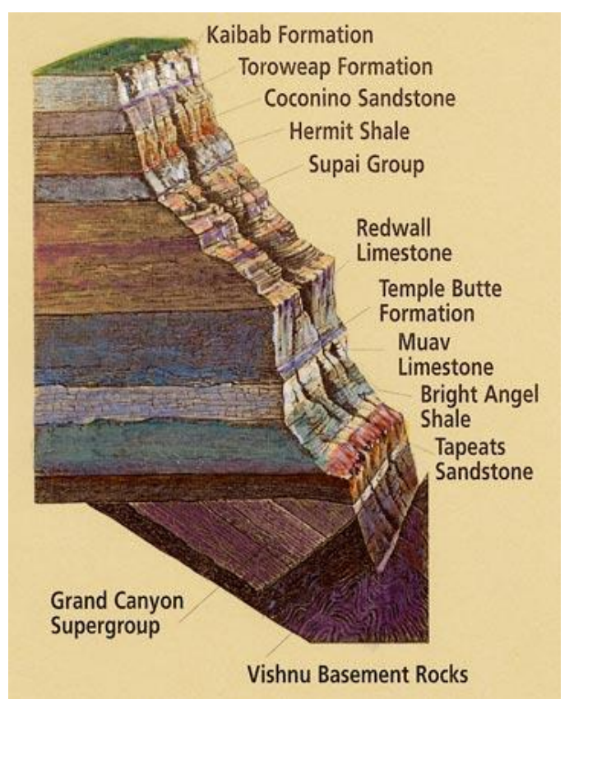
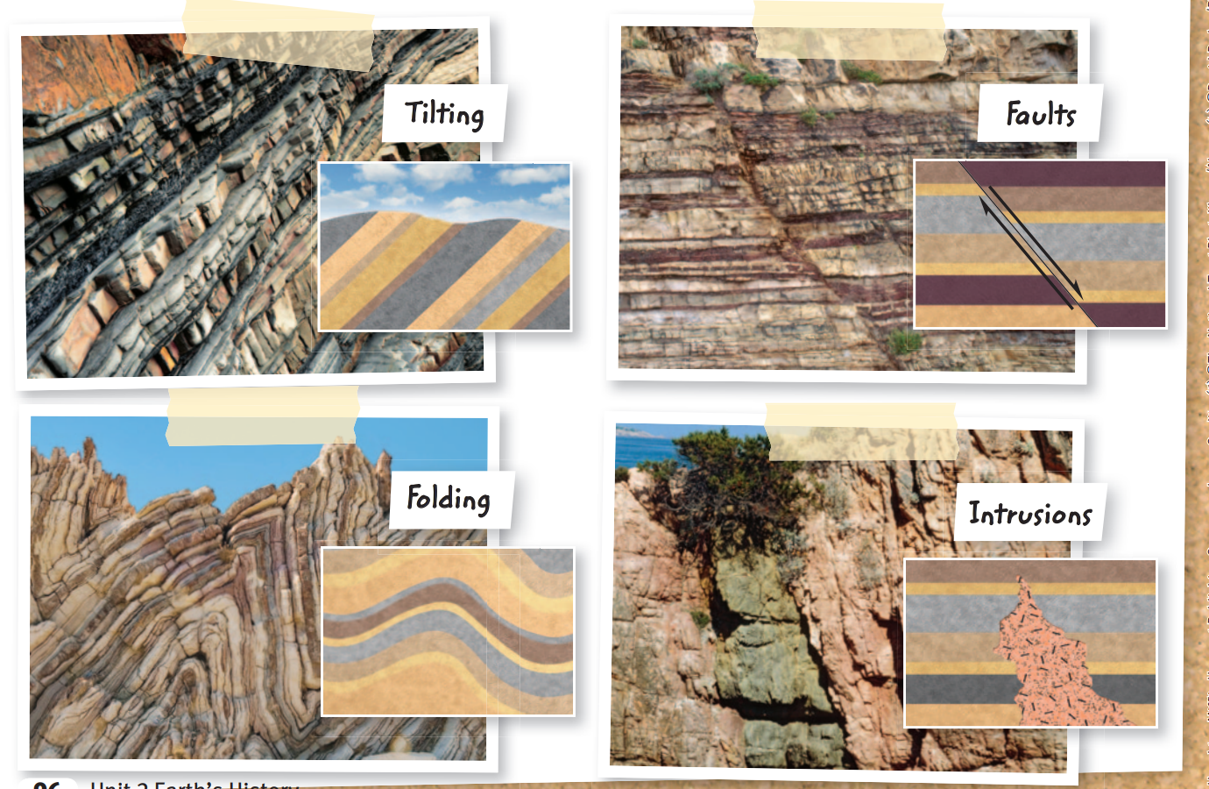
Grand Canyon
EQ: How are the relative ages of rock measured?
Answer:
Superposition
Superposition is the principle that states that _______ rocks lie above the _________ rocks if the layers have not been disturbed.
Q1: Find different colored rocks. Look on the ground and out across the canyon. Circle the colors of the rocks you seen:
Brown Red Pink Orange Green
Blue Black Yellow White
Other Colors_____
Q2: Interpreting the landscape begins with rocks. Each rock carries its own story. Pick a rock and write a story about that rock. (You can find more information at the museum).
Disconformity
If rock layers are not horizontal, it means that something disturbed them after they formed. Forces in Earth can disturb rock layers so much that older layers end up on top of younger layers. Some of the ways that rock layers can be disturbed are shown below.
Q3. Take a picture, sketch the shape and record the location of each feature you find during the trip.
Tilting:
Faults:
Folding:
Intrusions:

Slide 7
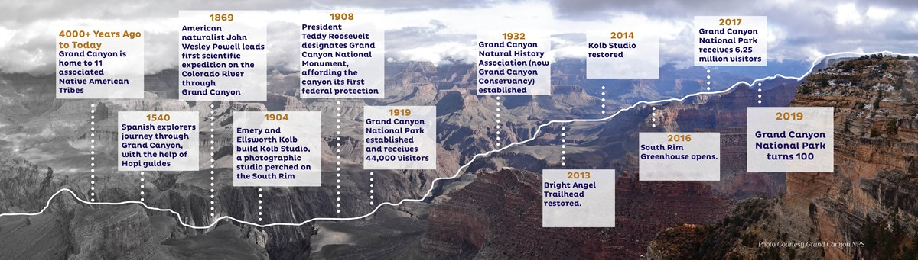
Grand Canyon 100 years old !!!!
Based on the timeline provided below, find answers to the following questions:
Q1. Why is Grand Canyon important to Native American Tribes?
Q2. When was the date that Grand Canyon National Park opened?
Q3. Who led the expedition of Grand Canyon?
Q4. Ask a park rancher about what special events the national park did to celebrate Grand Canyon's 100th years birthday.
Notes:
Many be you can do somethings

Slide 8
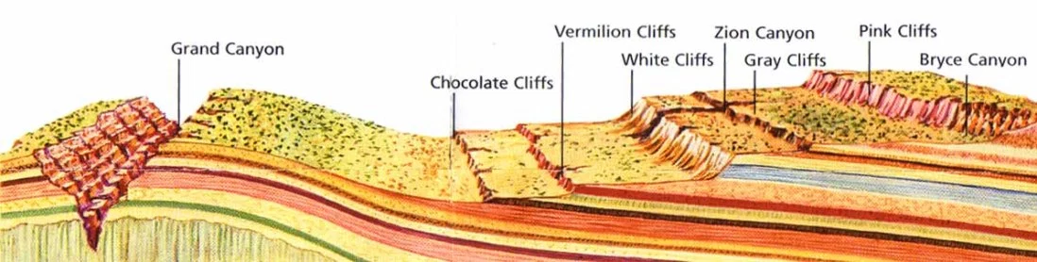
Activity: Grand Canyon
Activity 1. Many artists experience magic at Grand Canyon. They attempt to capture its beauty in essays, paintings, books, photographs, and sculptures that you can view at Kolb and Lookout studio.
Step 1; Record a short video- up to 30 seconds about your Grand Canyon experience.
Step 2: Sit quietly in a “ magic spot “ by yourself for 5 – 10 minutes. Draw a picture or write a short story or poem that reflects your feelings about your magic spot at Grand Canyon.
The Grand Staircase refers to an immense sequence of sedimentary rock that stretch south from Bryce Canyon National Park and Grand Staircase-Escalante National Monument, through Zion National Park, and into the Grand Canyon National Park. Bryce Canyon contains the youngest rock layer, while Grand Canyon contains the oldest rock layer.
7

Slide 9
Devotion
Psalm 121 I lift up my eyes to the mountains— where does my help come from? My help comes from the Lord, the Maker of heaven and earth. He will not let your foot slip— he who watches over you will not slumber; indeed, he who watches over Israel will neither slumber nor sleep. The Lord watches over you— the Lord is your shade at your right hand; the sun will not harm you by day, nor the moon by night. The Lord will keep you from all harm— he will watch over your life; the Lord will watch over your coming and going both now and forevermore.
[A Song of Providence] This is a song for the anxious and afraid. When all the voices of fear and accusation come rushing in, the pilgrim-disciple remembers that his help comes from the One who governs heaven and earth. Our Helper is also our Keeper. The One who watches over us does not sleep. The One who guards our souls cannot be moved. The God who paints the fields with wildflowers and tends to the sparrows is the same God who cares for us.
[Reflection] 1. What do you need God's help most right now? What are you thinking about as you read this song? 2. Is it easy or difficult for you to accept that God is able to help you? Why? 3. Which statements in this psalm encourage you most? Why? In what ways has God already shown that He has done everything described in this psalm?

Slide 10

Reflection

Slide 11
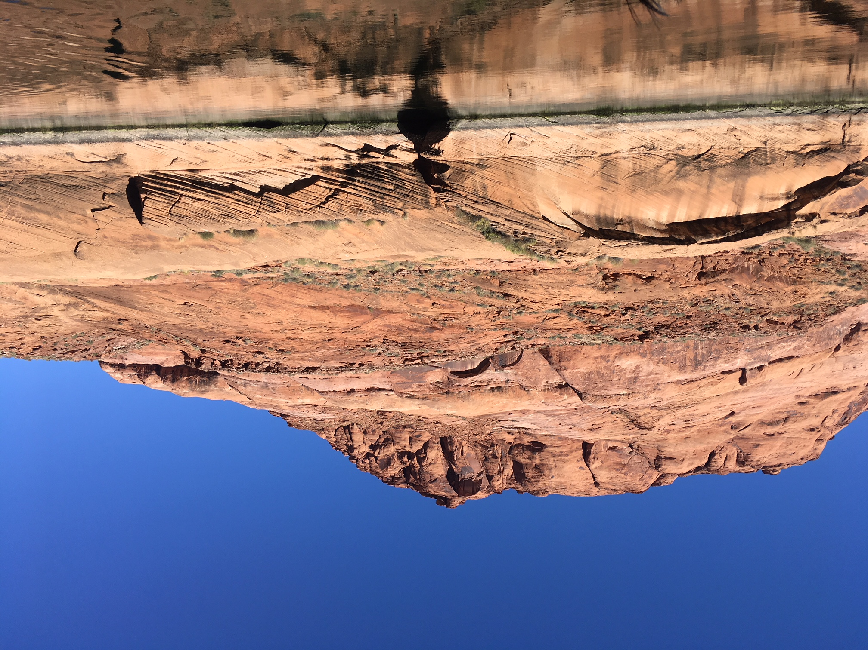
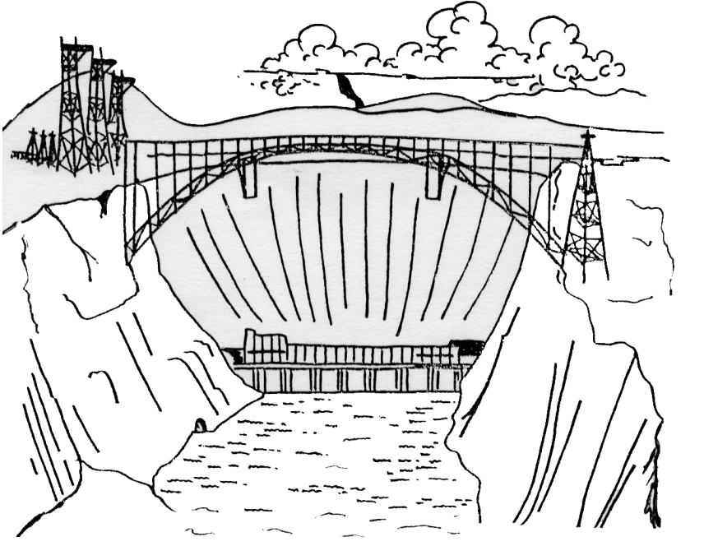
Glen Canyon
EQ: How does weathering change Earth’s Surface?
Answer:
Weathering
As you float down the Colorado river, observe the various rock texture carved out by the erosion of the river.
Q1. What is weathering ?
Q2. What is erosion?
Q3: What is deposition?
Q4.What is a canyon and how is it formed??
Glen Canyon Dam
The Glen Canyon Dam holds back the Colorado River to form Lake Powell. The dam creates electricity by sending river water through turbines deep within its structure. Take a tour of the dam, talk to a ranger or tour guide, or read the exhibits in the Carl Hayden Visitor Center to find the answers to the questions below.
Q5: How big is the Glen Canyon Dam?
Q6:Why did we build the Glen Canyon Dam?
Notes:
https://www.glencanyon.org/why-glen-canyon/

Slide 12
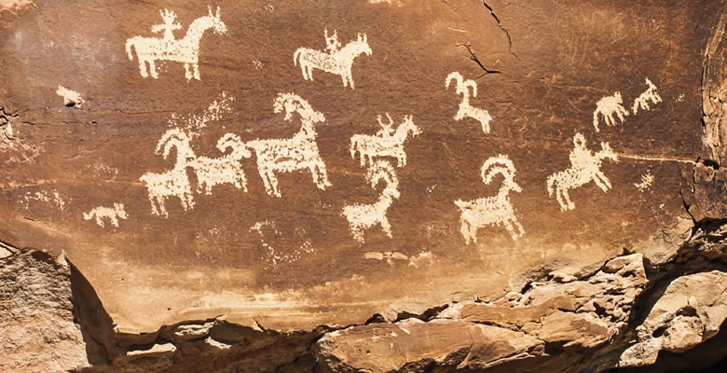
Glen Canyon Petroglyphs
While on the Colorado River float trip, you will find examples of petroglyphs, paintings or carvings on rock. Sketch some of the petroglyphs you see throughout the trip.
These petroglyphs have not been definitively explained. Select one glyph that interests you, depict it below, and tell the story you think the artist is sharing.

Slide 13
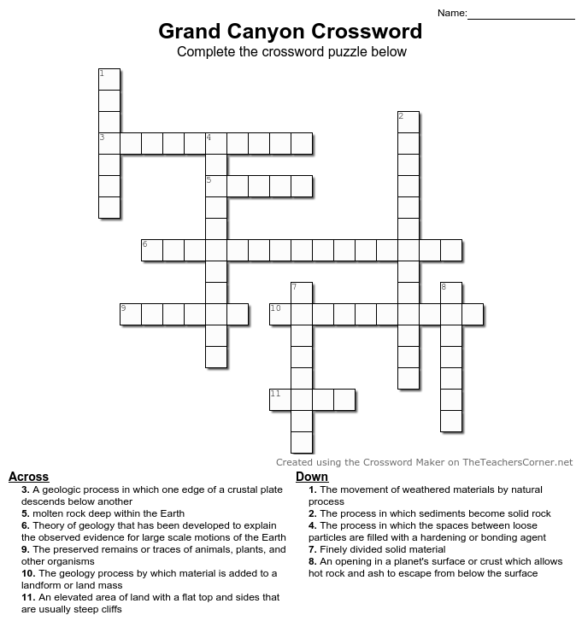
Activity

Slide 14
Devotion
Psalm 125 Those who trust in the Lord are like Mount Zion, which cannot be shaken but endures forever. As the mountains surround Jerusalem, so the Lord surrounds his people both now and forevermore. The scepter of the wicked will not remain over the land allotted to the righteous, for then the righteous might use their hands to do evil. Lord, do good to those who are good, to those who are upright in heart. But those who turn to crooked ways the Lord will banish with the evildoers. Peace be on Israel. [A Song of Belonging] The disciple sings of our security in God’s care. The Lord holds His scepter, and no one can wrest it from His hand. This is a humble song because it acknowledges the truth that our hope is secure—not because we are strong, but because God is. But in this song, we also confess that we need God’s intervention to keep us and hold us. We are likely to take up the scepter of wickedness and govern our own lives in evil, self-serving ways if He doesn’t stay our hand. wildflowers and tends to the sparrows is the same God who cares for us.
[Reflect] 1. Do you worry about ruining your life by making a wrong decision or committing a particular transgression? How fragile or stable do you think your own life is? Why? 2. What does it mean for God to be our King? How does His rule govern the world we live in? How does He govern us as individuals? 3. In what ways do you need God to intervene in your life and govern you? What have he done for you already?

Slide 15
Reflection

Slide 16
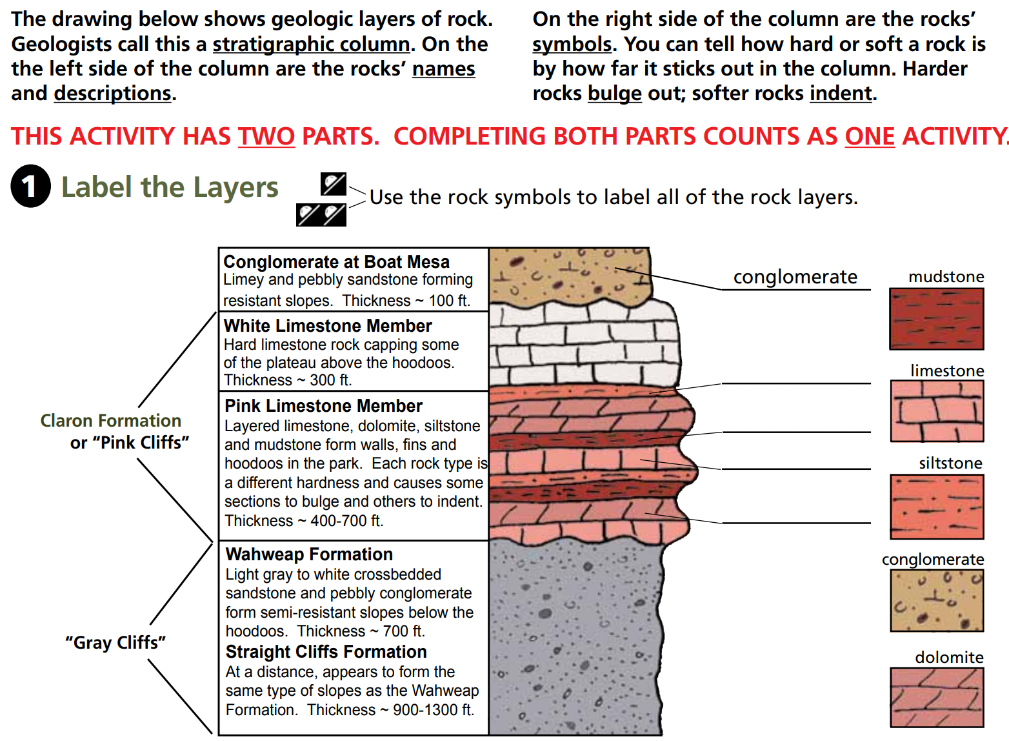
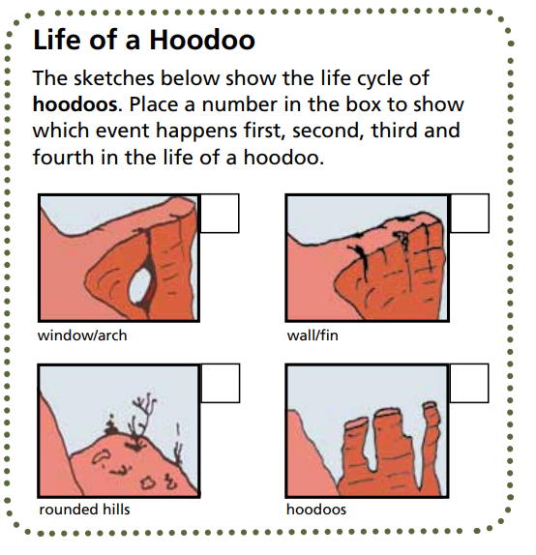
Bryce Canyon
EQ: How do we learn about Earth’s history?
Answer:
uniformitarianism catastrophism
Rock Layers
Hoodoo:
A hoodoo is a pinnacle or odd-shaped rock left standing from the forces of weathering and erosion.
Hoodoos don’t grow like trees but are eroded out of the cliffs where rows of narrow walls form. There thin walls of rock are called fins.
Q1. What is ice–wedging?
Q2: What types of climate do ice –wedging most likely to occur?
Notes:
Hoodoo: noun
A hoodoo is a pinnacle or odd-shaped rock left standing from the forces of weathering and erosion.
Hoodoos don’t grow like trees but are eroded out of the cliffs where rows of narrow walls form. There thin walls of rock are called fins. Frost-wedging enlarges cracks in the fins, creating holes or windows. As windows grow, their tops eventually collapse, leveling a comn. Rain further dissolves and sculpts there limestone pillars into bulbous spires called hoodoos.
The delicate climate balance between snow and rain ensures that new hoodoos will emerge while emerge while others become reduced to lumps of clay.

Slide 17

Thoughts on National Parks
As national parks were being created, there was a heated debate about whether the national parks should cast limited amount of visitors every day or to be open to all. Even today, this debate rages on.
Observe: Did you find any evidence of human in the national parks visited? Examples can be land degradation, air and noise pollution, littering, trampling and the alternation of ecosystems.
Interview: Talk to a park ranger and other tourists about their opinions on this debate. Record their answers below.
Reflect: Which side do you take? Should national parks be constrictive in their admittance policies, best preserving the natural sites, or should they be open to all to enjoy, to gain maximum profit? Choose a side and write your opinion

Slide 18
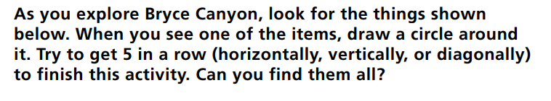
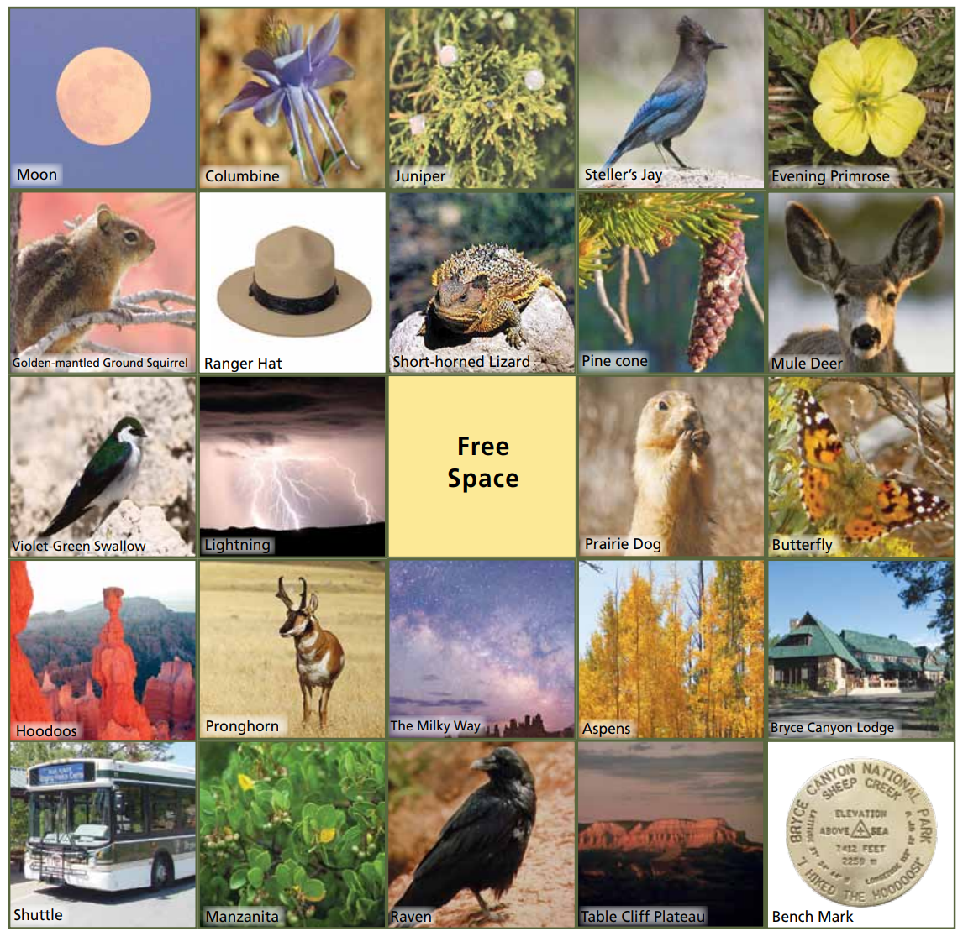
Bryce Canyon Bingo

Slide 19
Devotion
Psalm 40 I waited patiently for the Lord; he turned to me and heard my cry. He lifted me out of the slimy pit, out of the mud and mire; he set my feet on a rock and gave me a firm place to stand. He put a new song in my mouth, a hymn of praise to our God. Many will see and fear the Lord and put their trust in him. Blessed is the one who trusts in the Lord, who does not look to the proud, to those who turn aside to false gods.
Many, Lord my God, are the wonders you have done, the things you planned for us. None can compare with you; were I to speak and tell of your deeds, they would be too many to declare. Sacrifice and offering you did not desire— but my ears you have opened— burnt offerings and sin offerings[d] you did not require.
[A new song] This Psalm reads like a winding road, like a snapshot of various chapters in David’s life. There are times we hear David cry out from the pit of destruction, and times we see him singing a new song, his feet firmly on a rock (vv.1-3). There are moments of deliverance and moments when he is overtaken by his own sins (vv.9-13). David’s life is all over the place, just like mine and yours. There are stories of joy and stories of tragedy. As unpredictable as David’s life seems, this Psalm reminds us that God is more steadfast and faithful still. God had wonderful plans for David (v.5), He preserved David’s heart (v.10), and He was David’s help and deliverer (v.17). The Psalm even says that the Lord thinks of David—God is mindful of him (v.17). In all of David’s ups and downs, God proved Himself worthy to be trusted and praised. [Reflect] 1. How has your life seemed like a winding road? 2. What types of things has God delivered you from? 3. In all of your own personal ups and downs, how have you experienced the faithfulness of God? How can you show your gratitude for His faithfulness?

Slide 20
Reflection

Slide 21
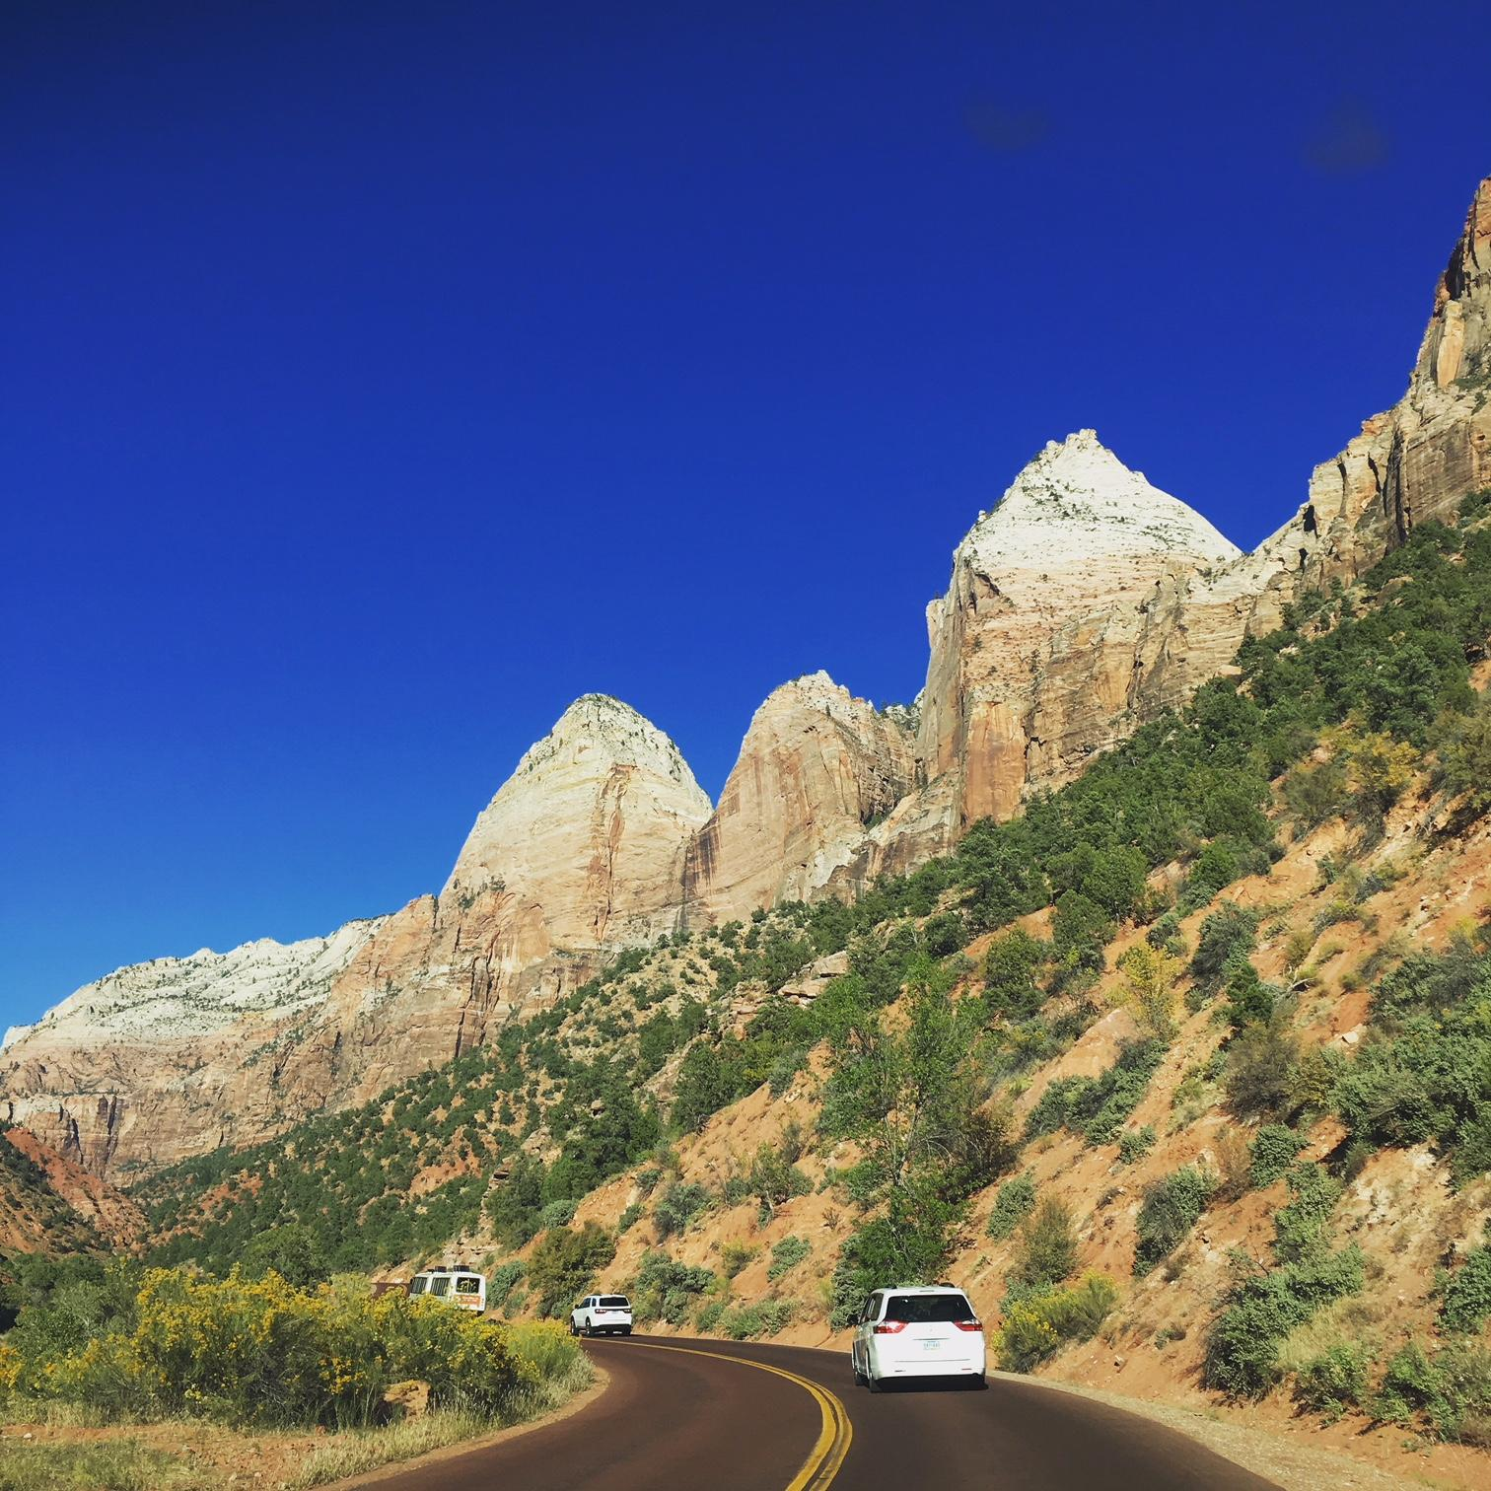
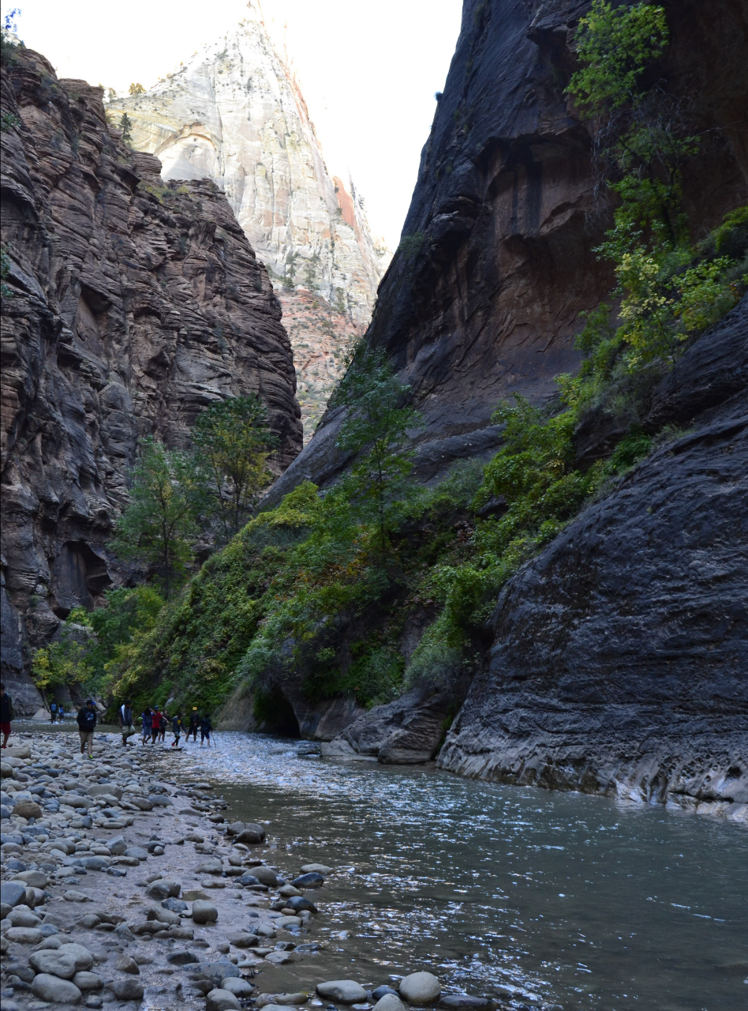
Zion National Park
EQ: How does flowing water change Earth’s Surface?
Answer:
Erosion
Q1. Did you see any warning signs along the trial? What is a flash flood? Do you see those signs when the canyon is narrow or wide?
Q2.Erosion occurs as soon as a rock particle moves. Based on your observation, what factors relate to a stream’s ability to erode material?
Soundscape
National parks like Zion offer more than beautiful landscapes, wildlife, and ancient rock art. Parks offer an opportunity to hear a unique sound environment, or soundscape. Exercise your listening skills and find out why Zion might sound different from your home.
Q3: List 5 different sounds you can hear in the park.

Slide 22
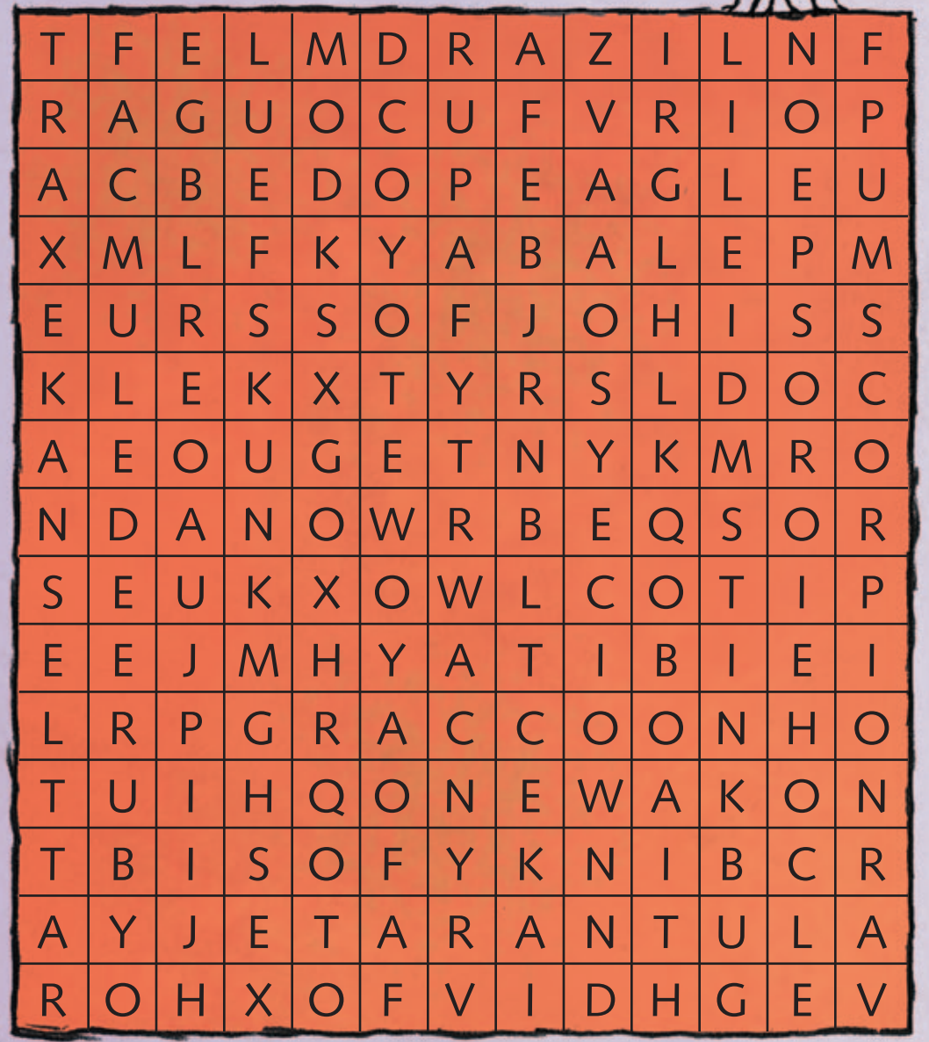
Animals of Zion Word Search
Zion is a biblical word meaning a place of peace and refuge or sanctuary. “Sing praises to the LORD, enthroned in Zion; proclaim among the nations what he has done.” - Psalm 9:11 How did Zion Canyon get its name?
Directions: Circle the animals from the list below in the puzzle. The words are hidden up, down, sideways, backwards, and diagonally. Hint: bat, tarantula, owl, mule deer, eagle, raccoon, stinkbug, fox, cougar, lizard, bighorn sheep, rattlesnake, coyote, scorpion, skunk

Slide 23
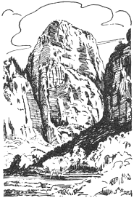
Psalm 125 -128
Zion: Spiritual Symbol of God’s Dwelling Place
Psalm 127 A song of ascents. Of Solomon.
1 Unless the Lord builds the house, the builders labor in vain. Unless the Lord watches over the city, the guards stand watch in vain.2 In vain you rise early and stay up late, toiling for food to eat— for he grants sleep to[d] those he loves.
3 Children are a heritage from the Lord, offspring a reward from him. 4 Like arrows in the hands of a warrior are children born in one’s youth. 5 Blessed is the man whose quiver is full of them. They will not be put to shame when they contend with their opponents in court. Psalm 128 A song of ascents.
1 Blessed are all who fear the Lord, who walk in obedience to him. 2 You will eat the fruit of your labor; blessings and prosperity will be yours. 3 Your wife will be like a fruitful vine within your house; your children will be
like olive shoots around your table. 4 Yes, this will be the
blessing for the man who
fears the Lord. 5 May the Lord bless
you from Zion; may you see the
prosperity of
Jerusalem
all the days of
your life. 6 May you live to
see your children’s
children— peace be on Israel.
Psalm 125 A song of ascents.
1 Those who trust in the Lord are like Mount Zion, which cannot be shaken but endures forever. 2 As the mountains surround Jerusalem, so the Lord surrounds his people both now and forevermore. 3 The scepter of the wicked will not remain over the land allotted to the righteous, for then the righteous might use their hands to do evil. 4 Lord, do good to those who are good, to those who are upright in heart.
5 But those who turn to crooked ways the Lord will banish with the evildoers. Peace be on Israel. Psalm 126 A song of ascents.
1 When the Lord restored the fortunes of[a] Zion, we were like those who dreamed.[b] 2 Our mouths were filled with laughter, our tongues with songs of joy. Then it was said among the nations, “The Lord has done great things for them.” 3 The Lord has done great things for us, and we are filled with joy. 4 Restore our fortunes,[c] Lord, like streams in the Negev. 5 Those who sow with tears will reap with songs of joy. 6 Those who go out weeping, carrying seed to sow, will return with songs of joy, carrying sheaves with them.

Slide 24
Reflection

Slide 25
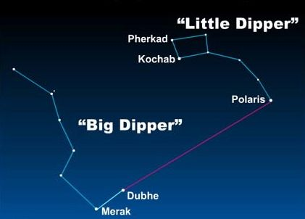
Zion Ponderosa Ranch
EQ: What makes up the universe?
Answer:
Finding Direction
You can use the Big Dipper to find Polaris, which is also known as the North Star. Notice that a line from the two outermost stars in the bowl of the Big Dipper points to Polaris
Stars, Galaxies and Planet
Q1. How does the composition of a start differ from the composition of a planet?
Q2. What does the moon look like from Earth today? Sketch the shape of the moon. What is the lunar phase today?

Slide 26
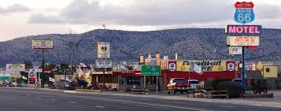
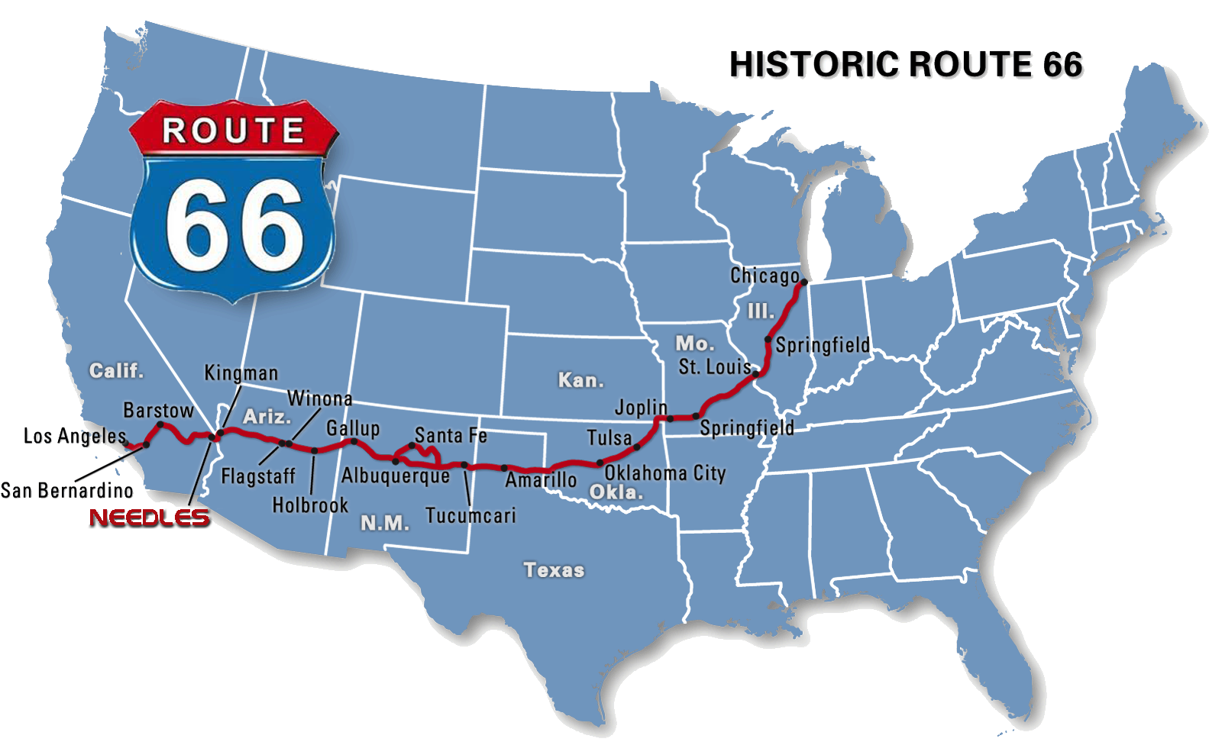
Life in a Small Town
Q1. What is the name of the towns that we stopped at during the trip? Label the location at the following map.
Q2: Do you want to live in a big city or in a small city? Why?

Slide 27

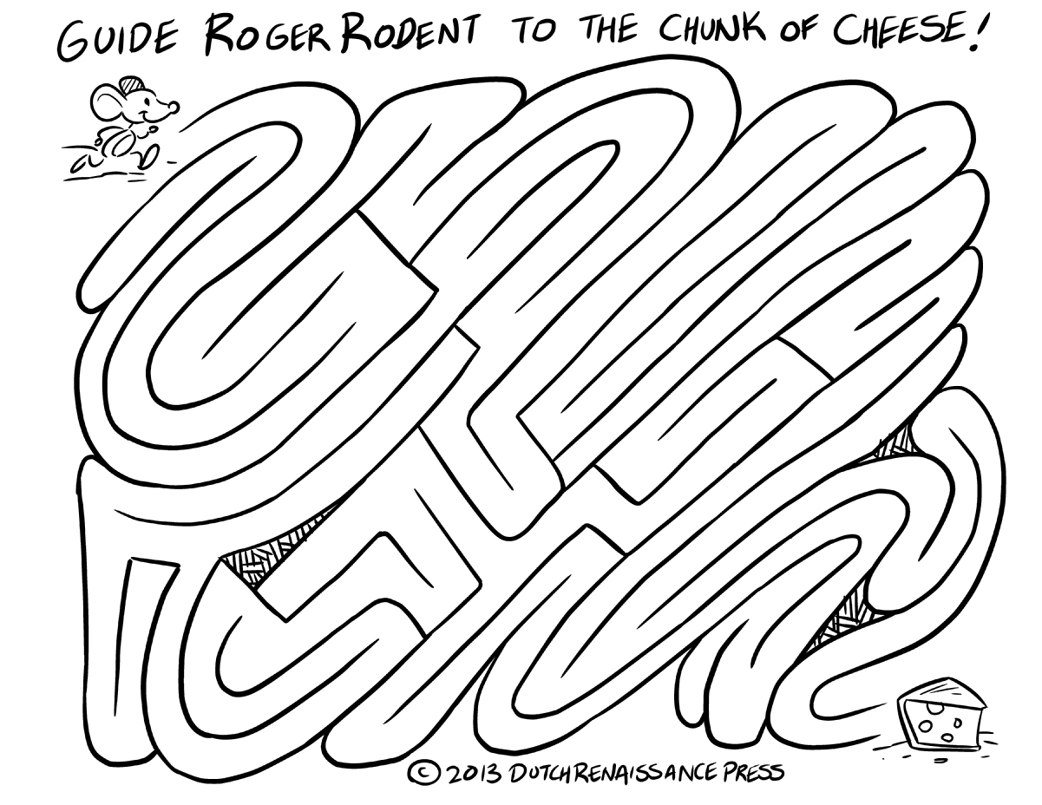
Rules for Tic-Tac-Toe 1. Two players alternate making empty squares, the first player marking X and the second player marking O. 2. If one player places three of the same marks in a row, that player wins 3. If the spaces are all filled and there is no winner, the game ends in a draw.
Tic-Tac-Toe

Slide 28
Reflection: How has the trip and its various experiences given you a greater view of who God is, and how He has blessed us with the gift of His creation?

Slide 29
Reflection

Slide 30
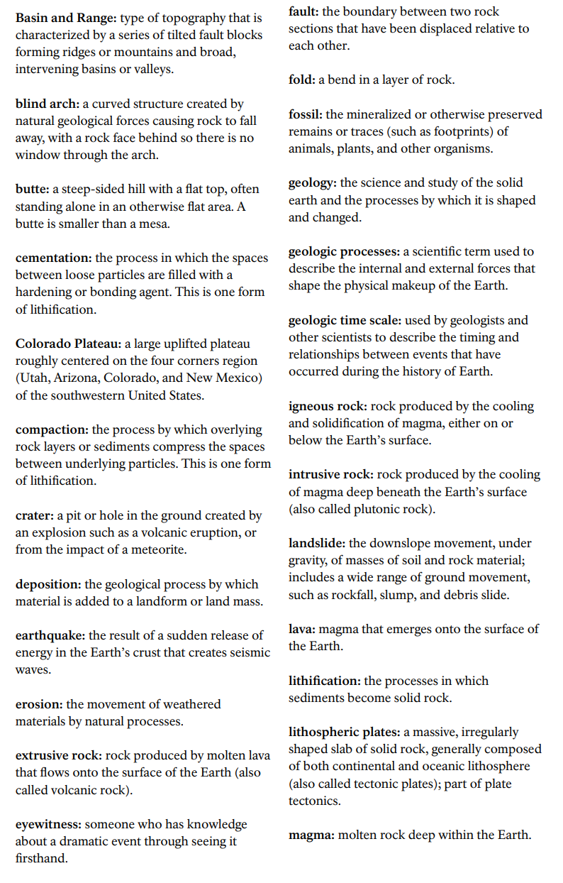
Glossary

Slide 31
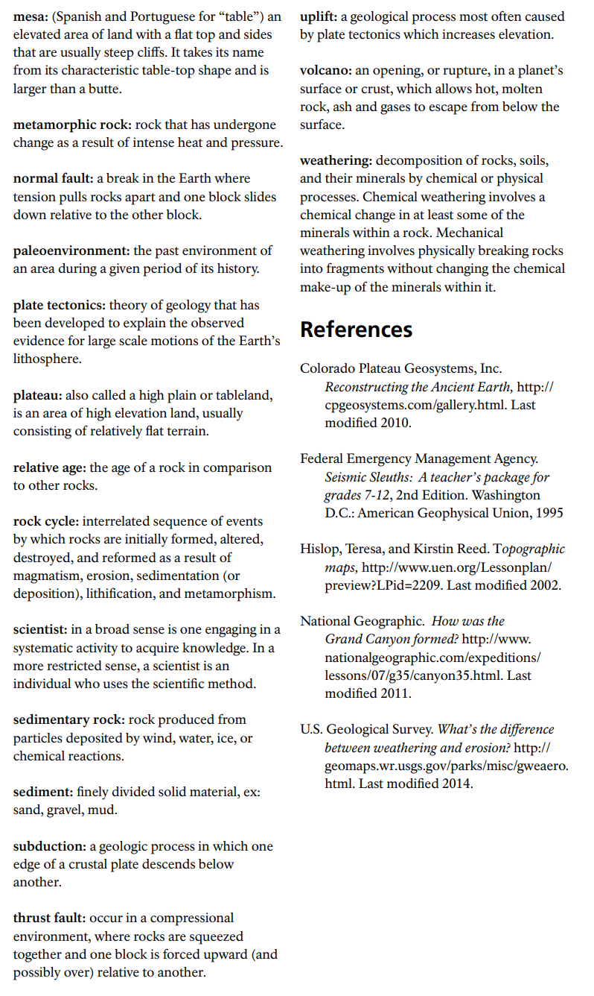

Slide 32
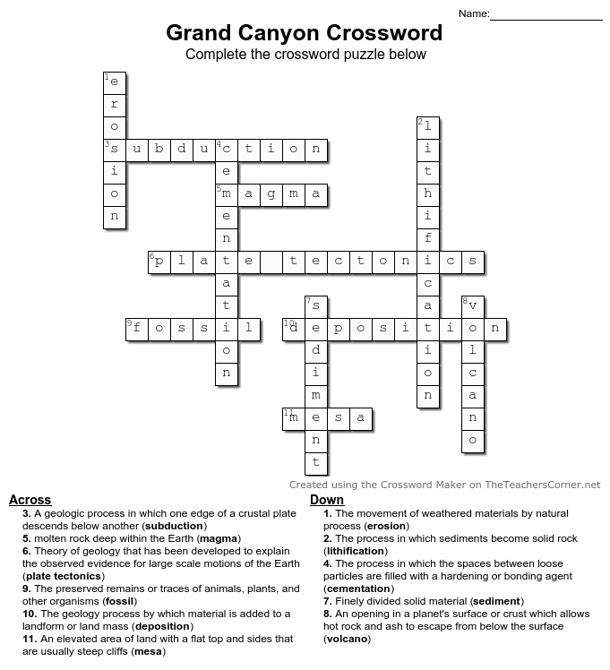
Answer Key

